Slide 2
Engineering Everywhere!
How much do you know about Engineering over the Ages?
Let’s find out!

Slide 3
Engineering Everywhere!
You’re going to look at some questions.
You’ll be shown three possible answers for each one.
All you have to do is to work out which one you think is right!

Slide 4
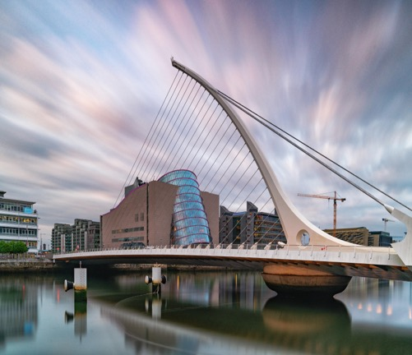
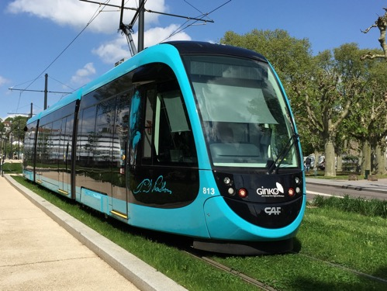
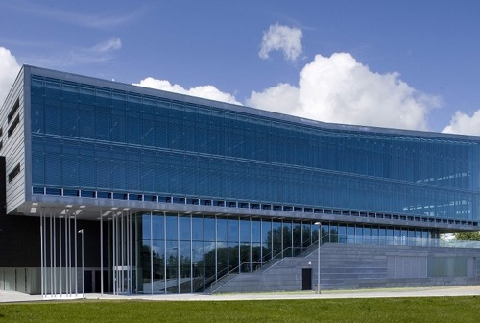
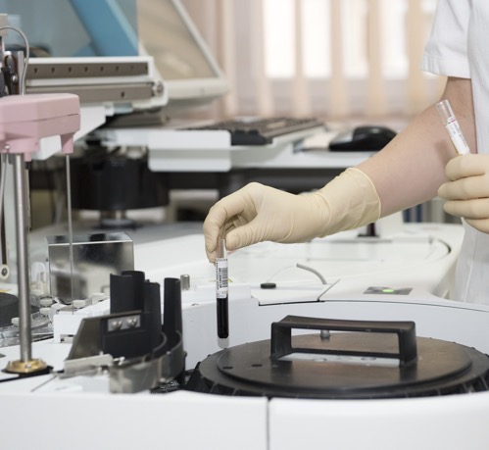
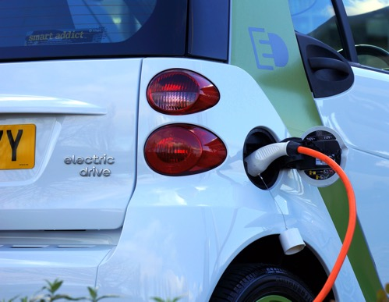
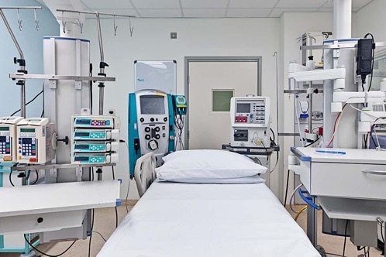
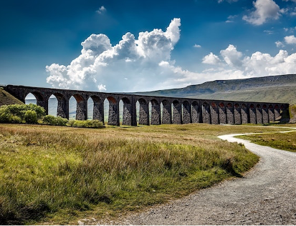
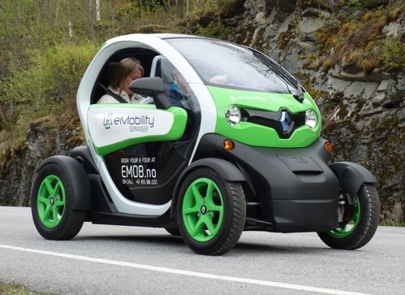
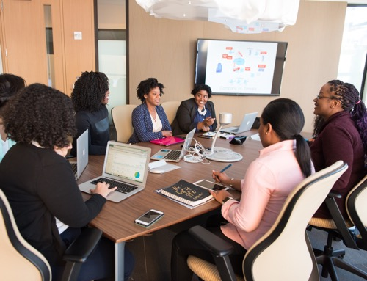
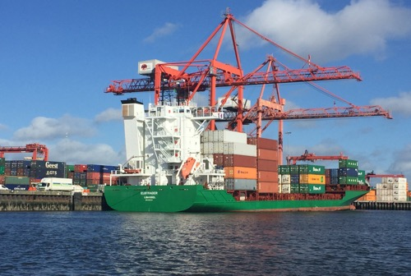
Engineering that
Changed the World!

Slide 5
Engineering 1

Slide 6
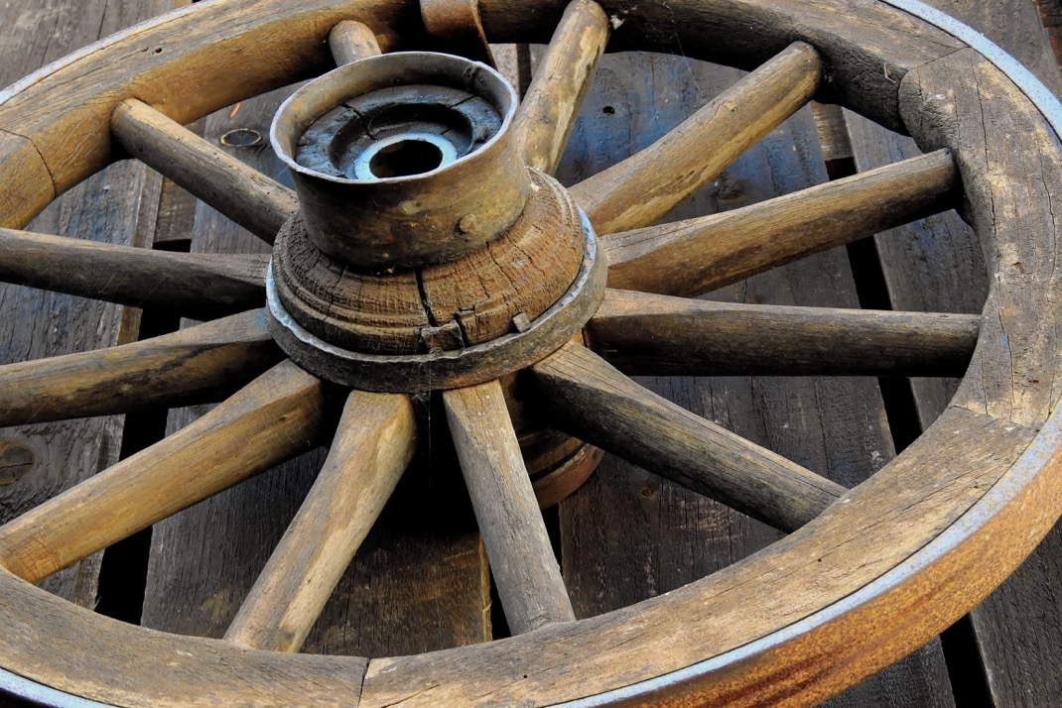
Key Engineering #1
The Wheel

Slide 7
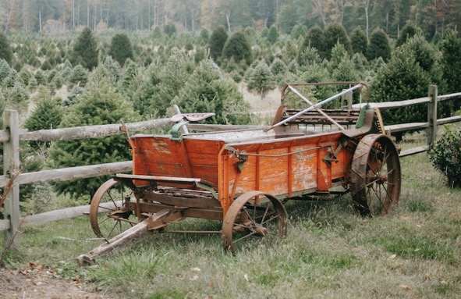
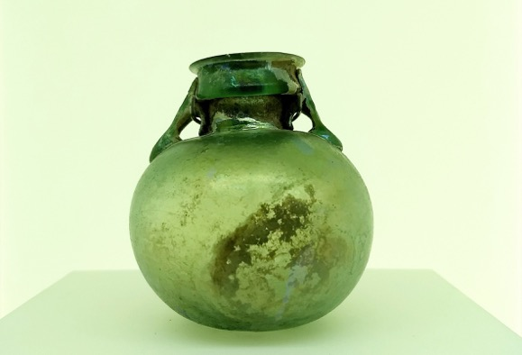
The Wheel
The wheel was first engineered as an innovation in what area?
Transport
Pottery
Food Preparation

Slide 8
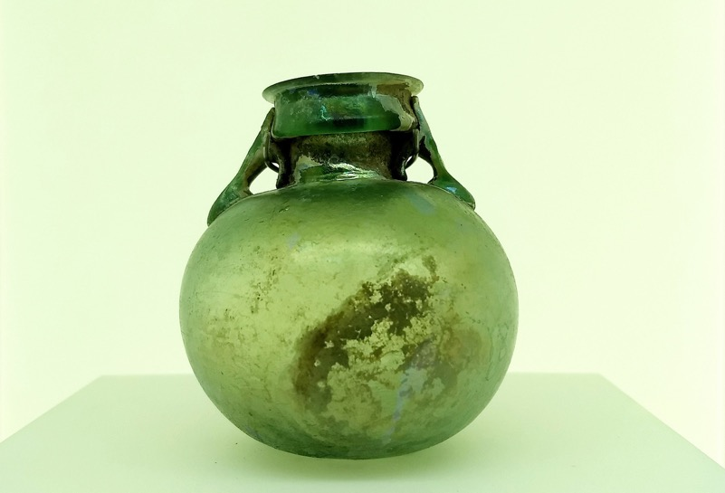
The Wheel & Pottery
The idea was so good that potters’ wheels are still being used today – all over the world.

Slide 9
Transport
There is no evidence of wheels in the UK before the Bronze Age, when they were used in transport. Carts with wheels made it much easier to take things to other villages and sell them.

Slide 10
Food Preparation
In the UK, cooked food only really became a reality when Stone Age humans discovered how to make and control fire.

Slide 11
Engineering 2

Slide 12
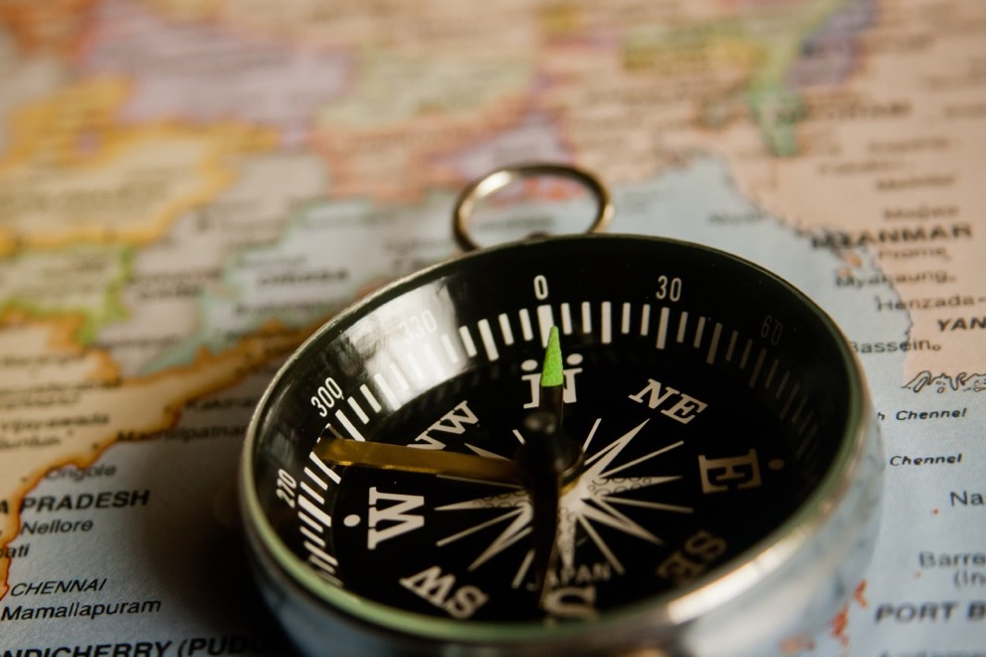
Key Engineering #2
The Compass

Slide 13
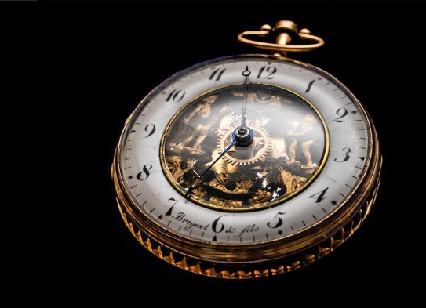
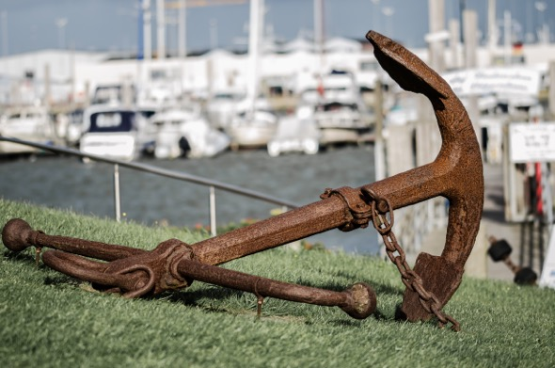
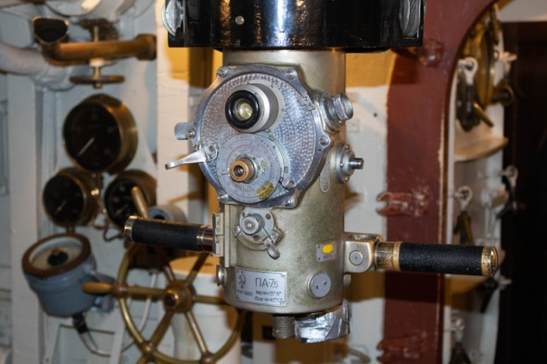
The Compass
Compasses have helped sailors navigate for more than 900 years. But which other innovation made them even more useful?
A Type of Clock
A Type of Anchor
A Type of Periscope

Slide 14
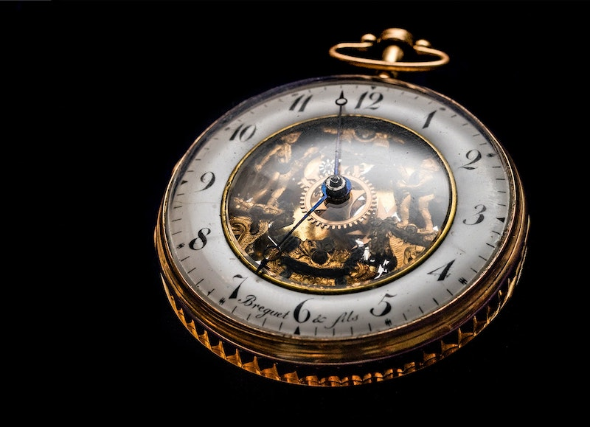
A Type of Clock
A compass uses magnetism. As it always points North, sailors can work out which way they need to go to get to where they want to be. But unless you know where you’re starting from, you’ve then got some tricky calculations to do!
Marine clocks solved this problem – if sailors exactly knew how long they had been travelling, they could work out where they had got to. Marine clocks are a British innovation – and go back nearly 300 years!

Slide 15
Anchors
Anchors slow ships down or stop them moving. The first ones were probably just buckets filled with rocks – and go back more than 2,500 years ago, in ancient Greece!

Slide 16
The Periscope
Periscopes use mirrors to help submarines see what is on the surface of the sea. They were an innovation of Victorian times – and are still going strong today!

Slide 17
Engineering 3

Slide 18
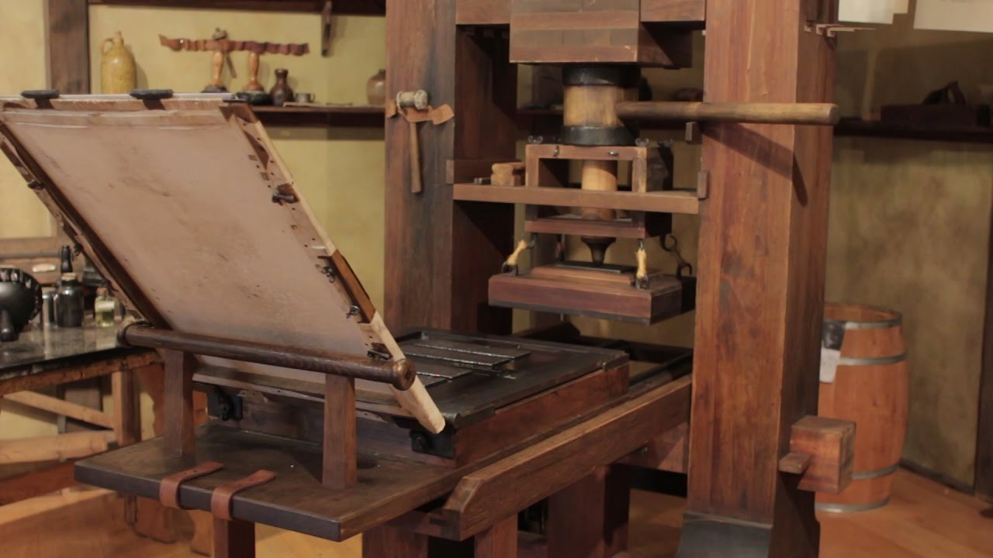
Key Engineering #3
The Printing Press

Slide 19
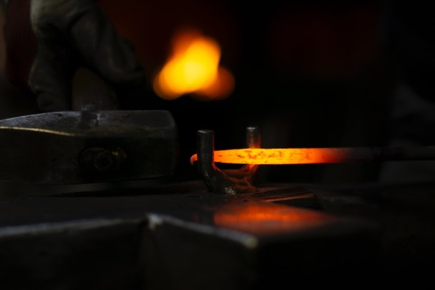
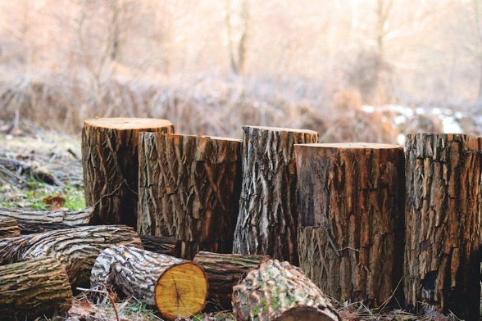
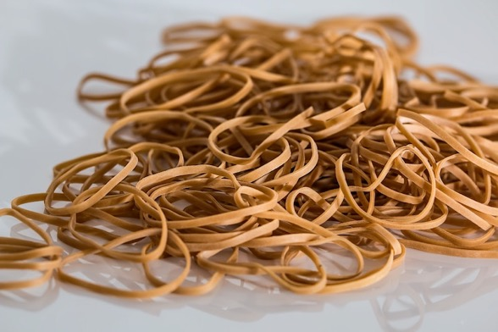
The Printing Press
The printing press made it easier for ordinary people to learn to read and write. Every letter had to be put into place individually – what were the letters made from?
Metal
Wood
Rubber

Slide 20
Metal
The printing press was first invented around 600 years ago – and meant that books didn’t have to be written by hand any more.
Metal letters didn’t need cleaning too often – and didn’t break easily. So the first printing press could print 250 copies of a page in just an hour!

Slide 21
Wood
Wooden blocks have been used for printing by hand for more than 2,300 years. But they are too easily damaged to be used in mechanical printing presses.

Slide 22
Rubber
Once scientists learnt how to work with rubber so that it didn’t get sticky when it was hot, it became very useful in printing. But this wasn’t until 180 years ago!

Slide 23
Engineering 4

Slide 24
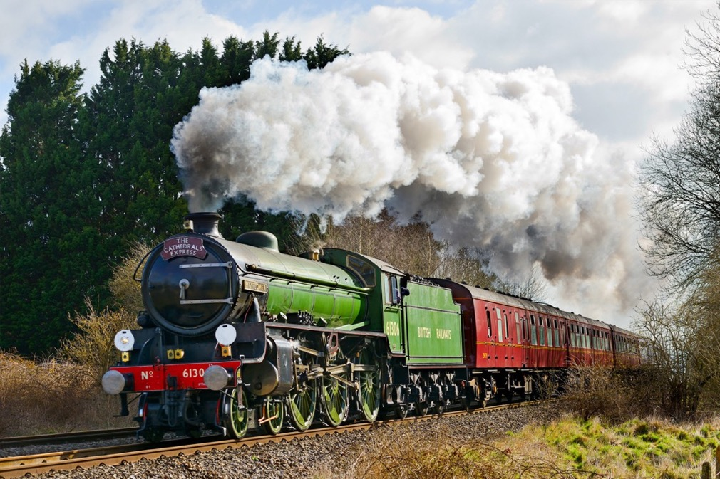
Key Engineering #4
The Steam Train

Slide 25
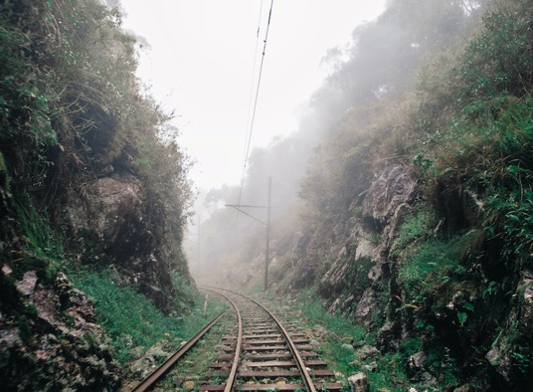
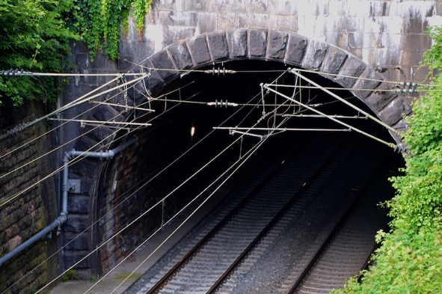
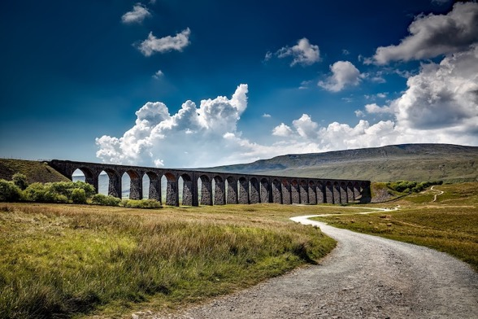
The Steam Train
Engineers first developed steam trains around 220 years ago. Engineers had to find ways to lay tracks in difficult situations. Which of these is a viaduct?
A
B
C

Slide 26
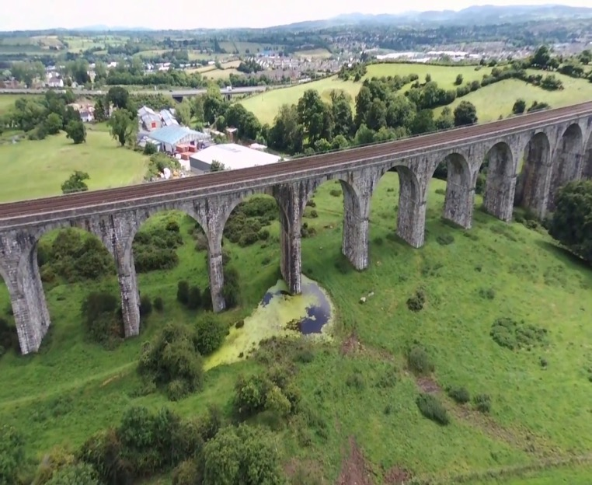
C!
Viaducts were actually a Roman innovation – and the word comes from Latin!
The railway engineers of the Industrial Revolution built some amazing railway viaducts. Craigmore Viaduct in Newry has 18 arches – the tallest rising to more than 40 metres. Astonishing engineering for something that was built nearly 170 years ago!

Slide 27
A: Cuttings
Railway cuttings are areas where soil or rock has been removed to make a trench where the tracks are laid. For safety reasons, the areas on either side see little human activity – so they attract lots of wild plants and animals. It’s true - railway engineers contribute to biodiversity!

Slide 28
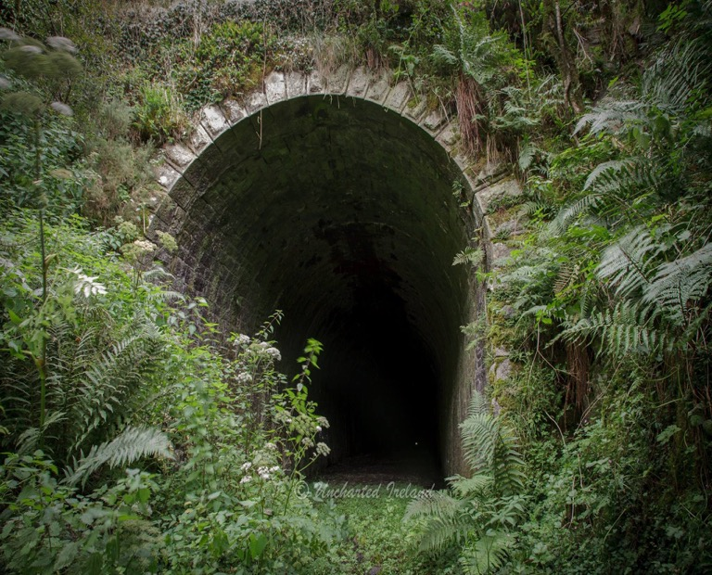
B: Tunnels
Railway tunnels are created in areas where cuttings are not possible. They have to be strong enough to stand the downward forces placed on them by the rock and soil above them – and, of course, of any traffic. Ireland’s longest tunnel is in Newry, too. The Lissummon Tunnel is over one and a half kilometres long – but it hasn’t been used since 1965.

Slide 29
Engineering 5

Slide 30
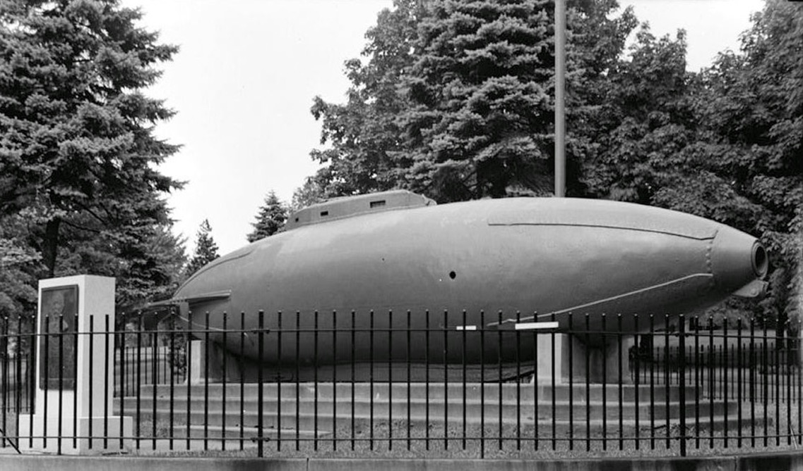
Key Engineering #5
The Submarine

Slide 31
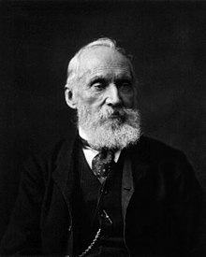
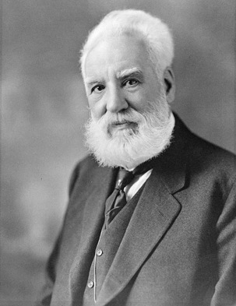
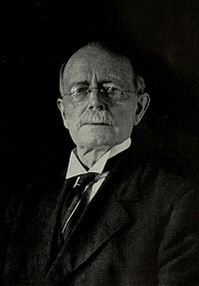
The Submarine
The first modern submarine was designed by an engineer who was born on the island of Ireland – but who was working in America at the time. What was his name?
William Thompson
John Philip Holland
Alexander Graham Bell

Slide 32
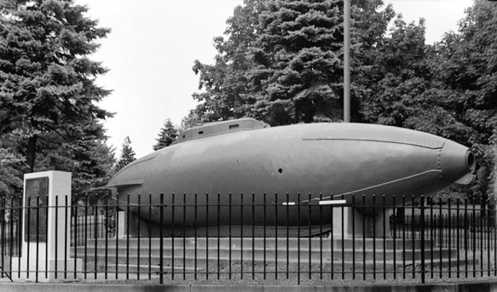
John Philip Holland
John Philip Holland was born in County Clare – but emigrated to the USA when he was thirty two years old. He broke his arm soon after arriving – and used his time in hospital to work on his submarine designs.
Just over 120 years ago, the USS Holland was launched as the American navy’s first submarine!

Slide 33
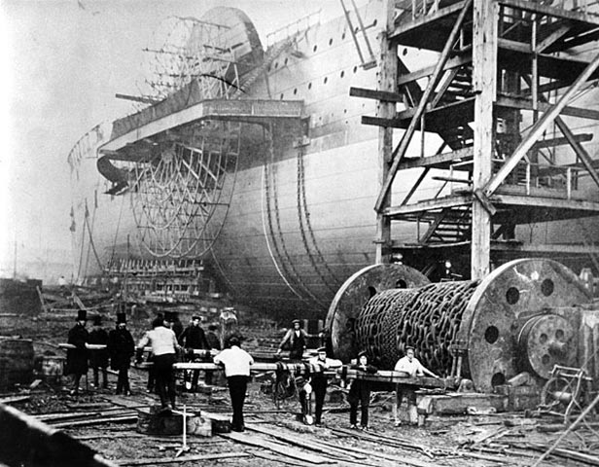
William Thompson
William Thompson (who became Lord Kelvin) was born in Belfast. And his engineering saw the first underwater cable between the British isles and America, over 150 years ago.
But he actually worked from a ship to do this – the SS Great Eastern!

Slide 34
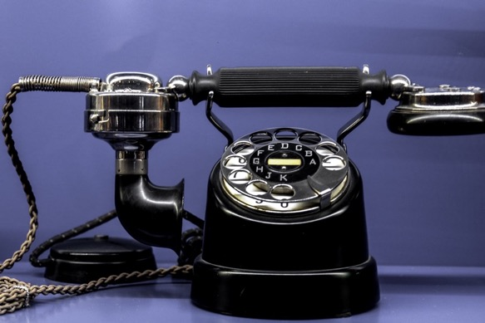
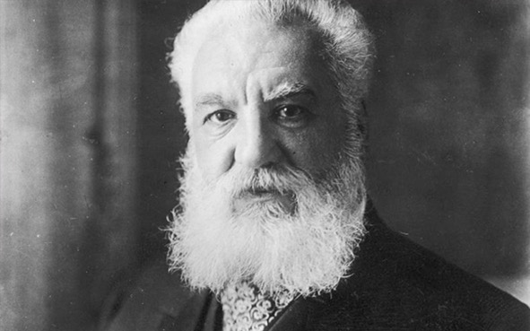
Alexander Graham Bell
The engineer Alexander Graham Bell was working in America when he invented the telephone, about 160 years ago.
But he was born in Scotland – not Ireland!

Slide 35
Engineering 6

Slide 36
Key Engineering #6
Sustainable Energy

Slide 37
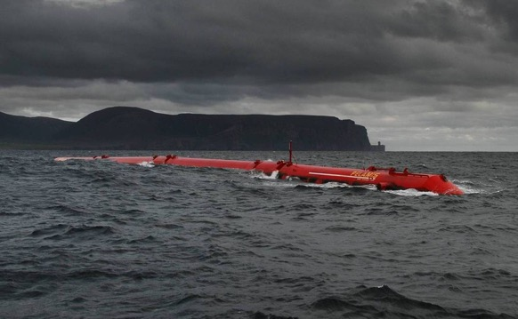
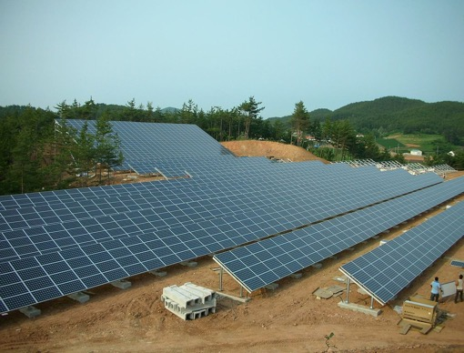
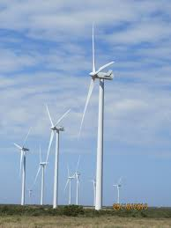
Sustainable Energy
Engineers are playing a vital role in the development of sustainable energy. Which of these now provides nearly 25% of Ireland’s energy?
Tidal Energy
Solar Energy
Wind Energy

Slide 38
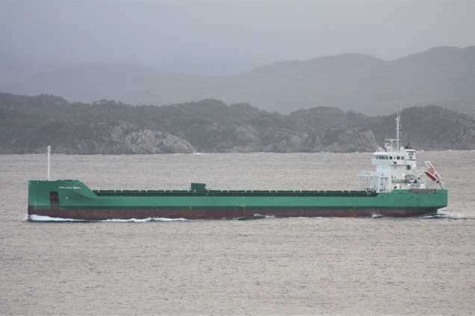
Wind Energy
Engineering gobbles energy up – but it’s now beginning to pay that energy back and help us all move towards a more sustainable future. In Ireland, wind power already makes up nearly a quarter of all the energy that’s used!
That proportion will only get bigger. There are plans to turn Arklow Bank, off Wicklow, into Ireland’s biggest wind farm yet – producing enough power for nearly half a million homes!

Slide 39
Solar Energy
Ireland’s climate means that solar power is never likely to provide huge amounts of energy. But engineers are dong what they can – and solar energy now provides 5% of the country’s needs!

Slide 40
Tidal Energy
For countries with long coastlines, tidal energy could one day be the backbone of sustainability. It is thought that tidal energy could potentially provide 75% of Ireland’s needs! And although there’s a lot still to be done, structural marine engineers are already onto the job!

Slide 41
Engineering 7

Slide 42
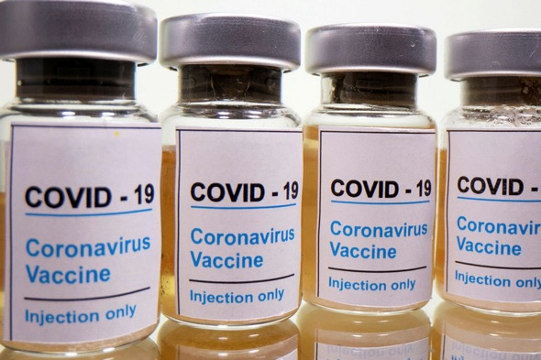
Key Engineering #7
COVID-19 Vaccines

Slide 43
COVID-19 Vaccines
Worldwide, scientists have done an amazing job creating vaccines against COVID-19. Now it’s the turn of engineers to play their role. Which of these parts of the supply chain have engineers been working on?
Production Lines
Refrigerated Transport
Safety

Slide 44
Production Lines
The demand for the small glass bottles that the vaccines come in (or vials) has never been higher. And engineers have had the job of adapting production lines so that millions can be produced in a short time. There’s no point having a vaccine if we don’t have anything to put it in!

Slide 45
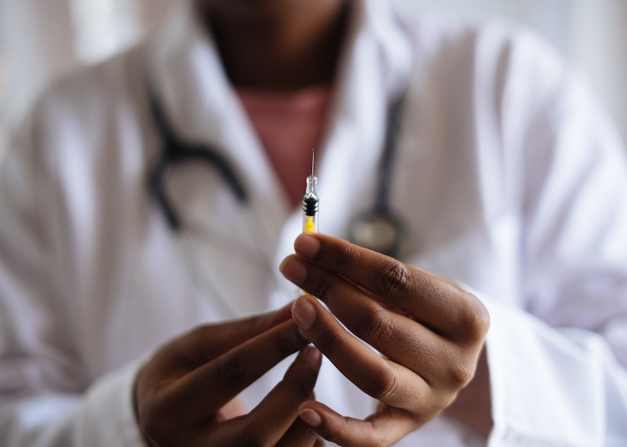
Refrigerated Transport
Most of the vaccines have to be kept at low temperatures – one at an extremely low temperature. So engineers have been busy designing lorries and containers that will keep the medicines cold until they arrive at their destinations. It’s no use making all those vials unless we can get them to where they need to be!

Slide 46
Safety
Vaccinators need to be confident that they will deliver exactly the right amount of the medicine every time. So both the tops of the bottles and the syringes have been designed by specialist engineers. It would be a huge waste of effort if all those vials got to where they needed to be, but then couldn’t be used safely!

Slide 47
COVID-19 Vaccines
All three answers were correct – because engineers have been working with scientists and medical professionals all over the world to make sure that the new vaccines can be manufactured in large quantities, transported to where they need to be and used safely. Because, don’t forget, no-one is safe until we’re all safe!

Slide 48
And Three Questions About …

Slide 49
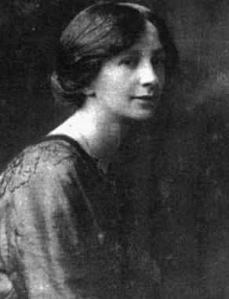
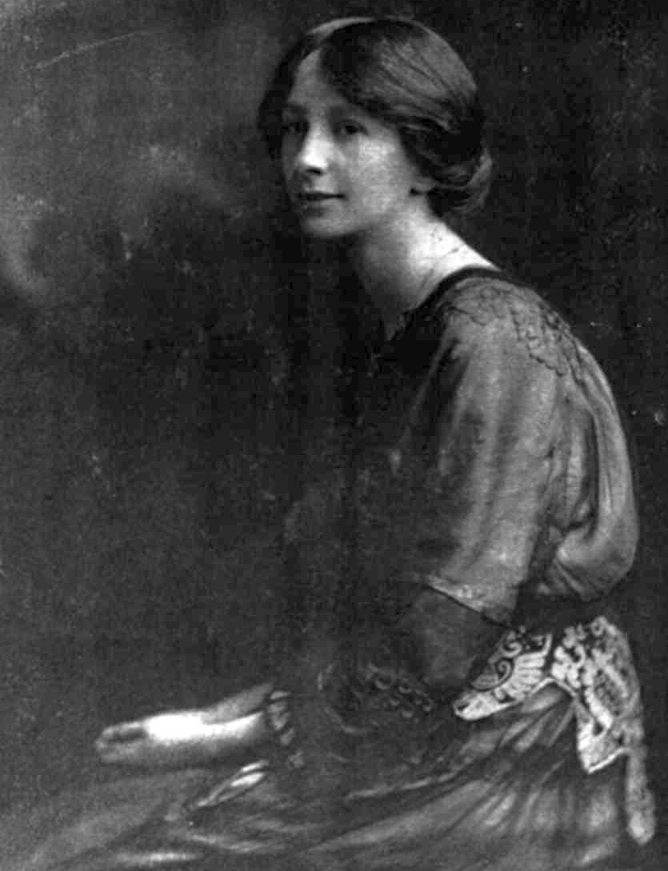
Alice Perry:
Trailblazer!

Slide 50
Alice Perry
(1885 – 1969)

Slide 51
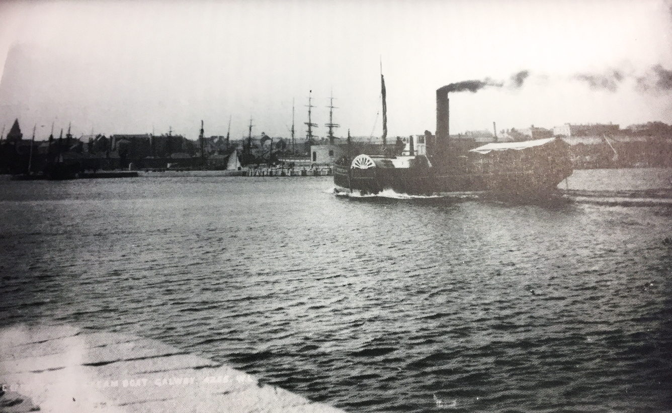
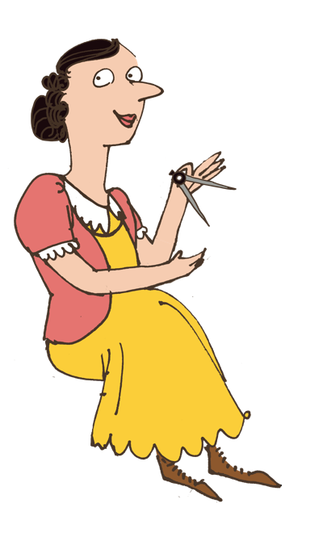
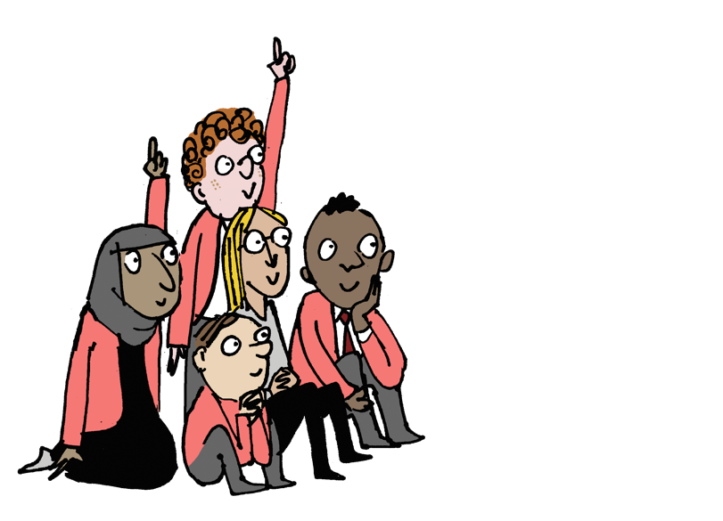
In 1906, Alice Perry became the first woman in Europe to graduate from university as … as a what …?

Slide 52
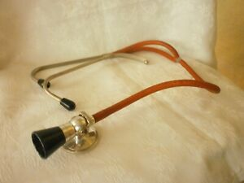
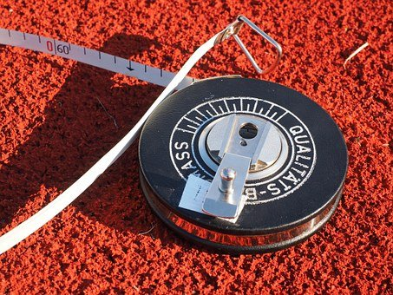
Alice Perry
In 1906, Alice Perry became the first woman in Europe to graduate from university as … as a what?
A Doctor
An Engineer
A Chemist

Slide 53
Alice Perry
An Engineer

Slide 54
Trailblazing Engineer
Alice went to university in Galway – and became the first woman in Europe (possibly the world) to get a degree in engineering. Women weren’t even allowed to vote in those days – so this was quite an achievement! The Engineering Building at her old university is named after her.

Slide 55
After working as the County Surveyor in Galway West, Alice took a similar job in which UK city …?

Slide 56
Alice Perry
After working as the County Surveyor in Galway West, Alice took a job in which UK city …?
London
Liverpool
Glasgow

Slide 57
Alice Perry
London

Slide 58
The Search for Work
Her job as County Surveyor was only temporary – and when she applied for it on a full-time basis it was given to a man! Looking for work suitable for her qualifications, she moved to London – where she got a job as a Factory Inspector (and she moved again, to Glasgow, a little later).

Slide 59
Alice eventually emigrated to America – where she put her understanding of form and structure to a different use. What did she become…?

Slide 60
Alice Perry
Alice eventually emigrated to America – where she put her understanding of form and structure to a different use. What did she become…?
A Painter
A Poet
A Playwright

Slide 61
Alice Perry
A Poet

Slide 62
Alice Perry: Trailblazer

